Slide 1
Hiring Process Analytics
By NELLURI ARAVIND

Slide 2
Description
Hiring process is the fundamental and the most important function of a company. Here, the MNCs get to know about the major underlying trends about the hiring process. Trends such as- number of rejections, number of interviews, types of jobs, vacancies etc. are important for a company to analyse before hiring freshers or any other individual. Thus, making an opportunity for a Data Analyst job here too!
Being a Data Analyst, your job is to go through these trends and draw insights out of it for hiring department to work upon.
In this project, we are provided with the data records of previous hirings and have been asked to answer certain questions making sense out of data.

Slide 3
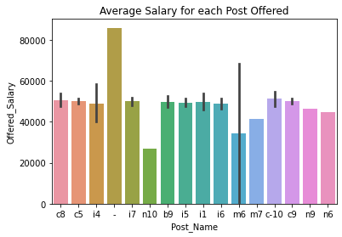
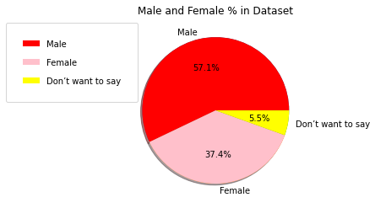
Approach
The first thing to complete the project is to export the data to your preferred editor(I’ve used Jupyter Notebook).
After the above the second major step is to design an efficient procedure which will answer all the asked/given questions about the dataset. Also Jupyter Notebook along with Python Programming Language can be used to create and plot precise and fine Graph/Charts/Visuals for Data.
Below are some of the Charts/Visuals created using Jupyter Notebook with Python Programming for the given Dataset.

Slide 4
Tech-Stack
MS PowerPoint - Documentation
MS Excel - For Getting logic and Viewing Dataset.
Jupyter Notebook - For loading database and writing the procedure to solve the given problem.
Python Programming - For writing the procedure ,creating charts/plots.
Jupyter Notebook Version - 6.4.5
Python Version - 3.8.2

Slide 5
Insights
Major Insights regarding the questions asked against the dataset can be viewed in the python file attached to it. Some of the insights ,I was able to discover are:
In the provided dataset we could see that the number of males being hired was more than the number of females hired.
Most of the people work with salaries ranging between 25000 to 50000.
Least number of people are working with salaries ranging between 0 to 25000.

Slide 6
Result and Drive Link
This project helped me in understanding the use of python programming language and its function to perform data analysis and also helped in discovering various plotting methods and features and draw out insights from those plots.
Drive Link : https://drive.google.com/drive/folders/1cq-CS0wab5P1LB_eeNEOj8XkRjJiyHby?usp=share_link

